Slide 1

History of the World, I Guess?
https://www.youtube.com/watch?v=iEO6mD2xpAY
(3:34- 4:13)

Slide 2
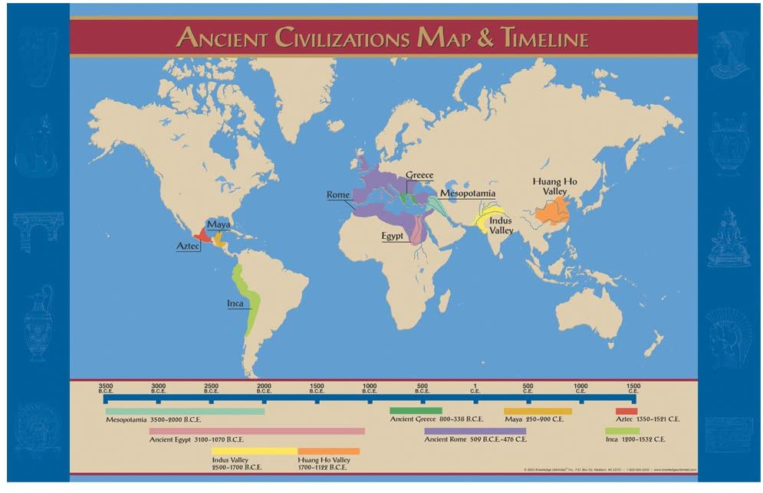
Focus: How did geographical features affect the development of early civilizations?
What geographic feature did early civilizations develop around? Why?
2. Where were the early civilizations located?

Slide 3
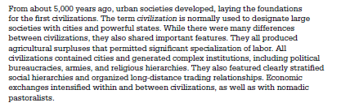
What is “civilization”?
Focus: Why do historians consider Mesopotamia be considered the “Cradle of Civilization”?
Early Neolithic villages eventually become more complex societies which practiced an urban rather than village lifestyle. As such, they are characterized by:
A strong centralized leadership (king or emperor) that coordinates the production storage and distribution of food and generates laws to protect property.
Job Specialization (weavers, metal workers, scribes, etc…) who rely upon the food producers to survive.-→More products=more trade
Social Hierarchies-Some individuals acquire more power, strength land (wealth) than others. The “others” often do the manual labor (farming, building, etc…)

Slide 4
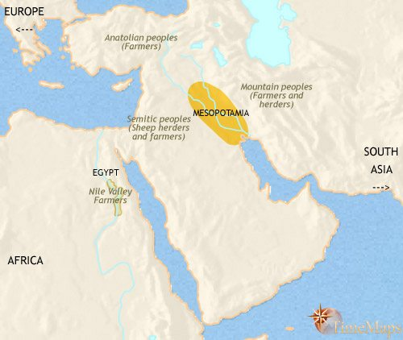
Mesopotamia and the World’s First Civilizations
Mesopotamia is the physical region- these are the civilizations: Sumerians, Akkadians, Babylonians and Assyrians.
Mesopotamia is located between the Tigris and Euphrates River.
Mesopotamia is a direct translation of ancient Greek meaning between two rivers! Μέσος ποτᾰμός
The heart of Mesopotamia today is Baghdad which is the capital of Iraq.

Slide 5
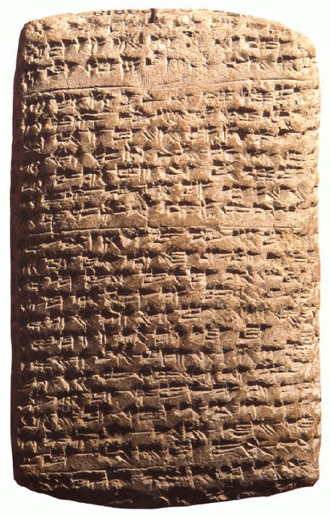
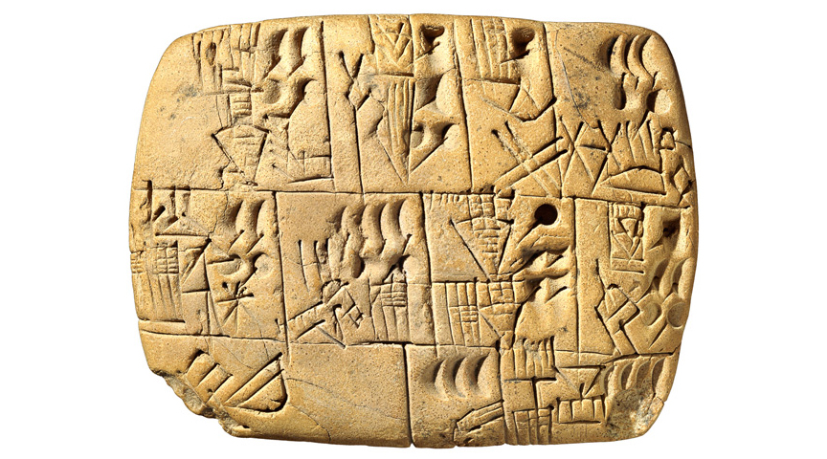
Mini-Lesson Focus: Why do historians consider Mesopotamia be considered the “Cradle of Civilization”?
Mesopotamian culture developed a system of writing called cuneiform. ~3200 BCE
Guiding Question: What benefits come from being able to write? What will this writing be used for?
The Fertile Crescent
Ancient Cuneiform on
Stone Tablet ~2000 BCE

Slide 6
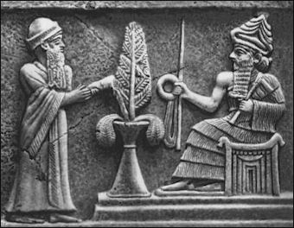
Mesopotamian GOVERNMENT
City-states: Were eventually united under
single rulers.
*Mesopotamia is often referred to as Sumer, the name of the first Kingdom in the region!
Ruled under a theocracy. The rulers were also the head of religion.
King Hammurabi (A Babylonian) created one of the earliest written law codes we have today. The Code of Hammurabi ~1750 BCE
Pertained to all aspects of life.
Reinforced social classes.

Slide 7
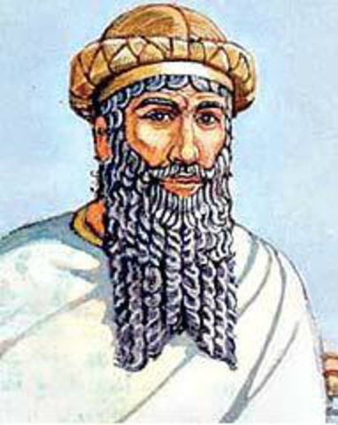
The Code of Hammurabi
Open the Document on Google Classroom!!!!

